Slide 1


Start Learning MongoDB
REST API DEVELOPMENT

Slide 2
Start Learning MongoDB
REST API DEVELOPMENT
আমাদের MongoDB শেখার কৌশল যা হচ্ছে
১ম ধাপঃ আমরা OS Terminal Console এ আগে Core MongoDB শিখবো । বেশির ভাগ ক্ষেত্রেই সবাই এই ধাপ এড়িয়ে যায়, পরে গিয়ে Core Knowledge কম থাকার কারনে, কাজে সমস্যা হয়।
২য় ধাপঃ এই ধাপে এসে আমরা Express এর সাথে MongoDB এর Use case গুলো শিখবো ।
৩য় ধাপঃ আমরা MongoDB এর Data Model এর জন্যে Mongoose শিখবো। এই ধাপে এসে Mongo নিয়ে থাকা অনেক ভুল ধারনা কেটে যাবে। Mongo can do everything
৪র্থ ধাপঃ একটা ছোট্ট BLOG এর জন্যে API Project করবো।
৫ম ধাপঃ সার্ভারে Mongo Database server configure করা শিখবো ।

Slide 3
MongoDB
REST API DEVELOPMENT
What is MongoDB: MongoDB is a cross-platform, document oriented database.
Provides high performance
High availability
Easy scalability
It is no SQL
written in C++

Slide 4
MongoDB
REST API DEVELOPMENT
MongoDB can manage:
Structured data
Semi structured data
Un structured data

Slide 5
MongoDB
REST API DEVELOPMENT
NoSQL Databases: NoSQL Database is used to refer a non-SQL or non-relational database.
No table
No row
No complex join

Slide 6
MongoDB
REST API DEVELOPMENT
NoSQL Behind History:
In the early 1970, Flat File Systems are used, that time there was no standard, no format difficult to manage and share.
In 1970 Computer scientist Edgar F. Codd proposed a database model to resolve this problem, known as relational database model
But later relational database also get a problem that it could not handle big data, due to this problem there was a need of database which can handle every types of problems.
The initial development of NoSQL database MongoDB began in 2007 by 10gen, the the company name changed with new name MongoDB Inc.
Later in 2009, it is introduced in the market as an open source database server
The first ready production of MongoDB has been considered from version 1.4 which was released in March 2010.

Slide 7
MongoDB
REST API DEVELOPMENT
Basic terminology:
RDBMS | MongoDB
Database | Database
Table | Collection
Tuple/Row | Document
column | Field
Table Join | Embedded Documents
Primary Key | Primary Key (Default key _id provided by MongoDB itself)

Slide 8
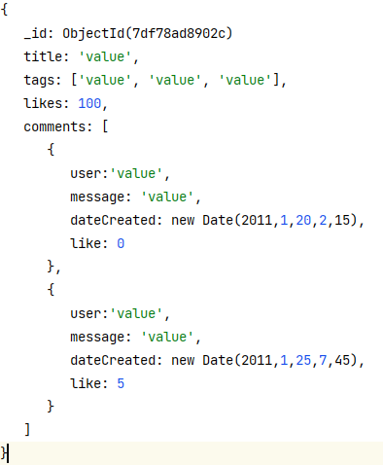
MongoDB
REST API DEVELOPMENT
Sample Document: :
Default key _id Definition:
_id is a 12 bytes hexadecimal number
First 4 bytes = current timestamp
Next 3 bytes = machine id
Next 2 bytes = process id
Last 3 bytes = incremental VALUE

Slide 9
MongoDB
REST API DEVELOPMENT
Advantages:
Schema less
single object
No complex joins
Deep query-ability
Tuning
Ease of scale-out
Uses internal memory for storing

Slide 10
MongoDB
REST API DEVELOPMENT
Where to Use MongoDB?
Big Data
Content Management and Delivery
Mobile and Social Infrastructure
User Data Management
Data Hub

Slide 11
MongoDB
REST API DEVELOPMENT
MongoDB edition:
MongoDB Community Server
MongoDB Enterprise Server
MongoDB Atlas

Slide 12
MongoDB
REST API DEVELOPMENT
Install MongoDB:
Download MongoDB Community Server
Install MongoDB Community Server on the local machine
Download MongoDB Compass
Install MongoDB Compass
Connect MongoDB With Compass Application

Slide 13
MongoDB
REST API DEVELOPMENT
MongoDB - Data Modeling:
MongoDB provides two types of data models
Embedded Data Model
Normalized Data Model

Slide 14
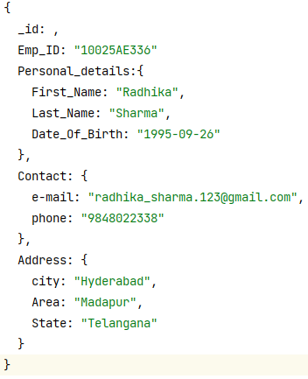
MongoDB
REST API DEVELOPMENT
Embedded Data Model: In this model, you can have (embed) all the related data in a single document, it is also known as de-normalized data model.

Slide 15

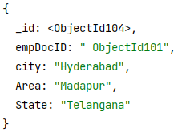
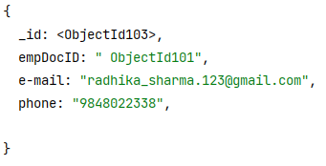
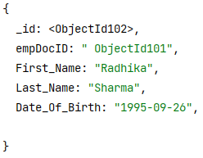
MongoDB
REST API DEVELOPMENT
Normalized Data Model: In this model, you can refer the sub documents in the original document.

Slide 16
MongoDB
REST API DEVELOPMENT
Datatypes:
Data Types | Description
String | String is the most commonly used datatype. It is used to store data. A string must be UTF 8 valid in mongodb.
Integer | Integer is used to store the numeric value. It can be 32 bit or 64 bit depending on the server you are using.
Boolean | This datatype is used to store boolean values. It just shows YES/NO values.
Double | Double datatype stores floating point values.
Min/Max Keys | This datatype compare a value against the lowest and highest bson elements.
Arrays | This datatype is used to store a list or multiple values into a single key.
Object | Object datatype is used for embedded documents.
Null | It is used to store null values.
Symbol | It is generally used for languages that use a specific type.
Date | This datatype stores the current date or time in unix time format. It makes you possible to specify your own date time by creating object of date and pass the value of date, month, year into it.

Slide 17

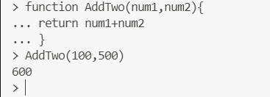
MongoDB
REST API DEVELOPMENT
MongoDB Shell:
The mongo shell is similar to the mysql in MySQL, psql in PostgreSQL, and SQL*Plus in Oracle Database.
The mongo shell is an interactive JavaScript interface to MongoDB.
The mongo shell is included in the MongoDB installation by default.

Slide 18
MongoDB
REST API DEVELOPMENT
MongoDB Help:
Type db.help() in MongoDB client. This will give you a list of commands as shown in the following screenshot.

Slide 19
MongoDB
REST API DEVELOPMENT
MongoDB Statistics:
To get stats about MongoDB server, type the command db.stats() in MongoDB client. This will show the database name, number of collection and documents in the database.

Slide 20
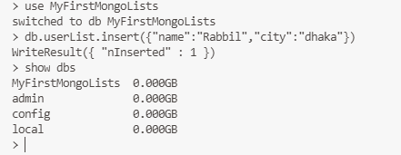
MongoDB
REST API DEVELOPMENT
Create Database:

Slide 21
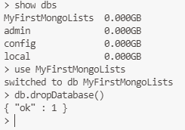
MongoDB
REST API DEVELOPMENT
Drop Database:

Slide 22
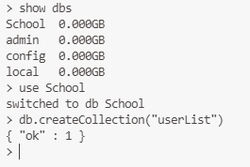
MongoDB
REST API DEVELOPMENT
Create Collection:

Slide 23
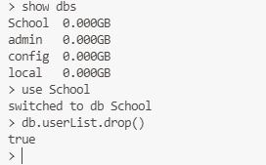
MongoDB
REST API DEVELOPMENT
Drop Collection:

Slide 24
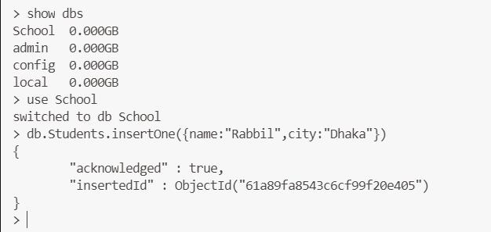
MongoDB
REST API DEVELOPMENT
The insertOne() method allows you to insert a single document into a collection.

Slide 25
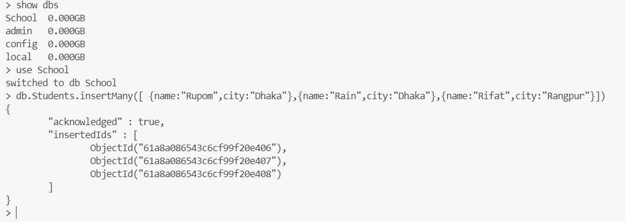
MongoDB
REST API DEVELOPMENT
The insertMany() allows you to insert multiple documents into a collection.

Slide 26
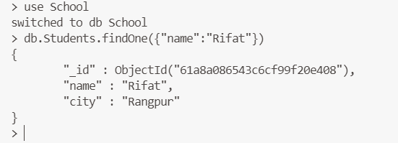
MongoDB
REST API DEVELOPMENT
MongoDB find:
The findOne() returns a single document from a collection that satisfies the specified condition.

Slide 27
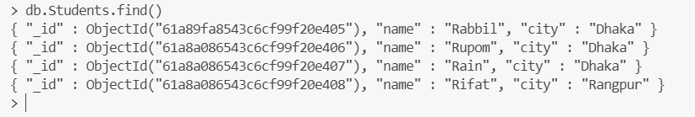
MongoDB
REST API DEVELOPMENT
MongoDB find:
The find() method finds the documents that satisfy a specified condition and returns a cursor to the matching documents.

Slide 28
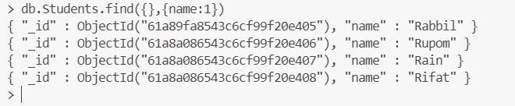
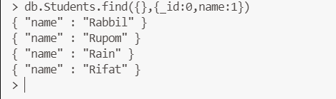
MongoDB
REST API DEVELOPMENT
MongoDB Projection:
In MongoDB, projection means selecting only the necessary data rather than selecting whole of the data of a document.

Slide 29
MongoDB
REST API DEVELOPMENT
Query Operators:
$eq: Equal To Operator
$lt: Less Than Operator
$lte: Less Than or Equal To Operator
$gt: Greater Than Operator
$gte: Greater Than or Equal To Operator
$ne: Not Equal To Operator
$in: In Operator
$nin: Not In Operator

Slide 30
MongoDB
REST API DEVELOPMENT
Query Operators:
db.Products.find({price:{$eq:"1000"}})
db.Products.find({price:{$lt:"1000"}})
db.Products.find({price:{$lte:"1000"}})
db.Products.find({price:{$gt:"1000"}})
db.Products.find({price:{$gte:"1000"}})
db.Products.find({price:{$ne:"1000"}})
db.Products.find({price:{$in:["100","200","3000"]}},{price:1})
db.Products.find({price:{$nin:["100","200","3000"]}},{price:1})

Slide 31
MongoDB
REST API DEVELOPMENT
Logical Operators:
$and: Logical AND Opeartor
$or: Logical OR Operator

Slide 32
MongoDB
REST API DEVELOPMENT
Limit Records :
To limit the records in MongoDB, you need to use limit()

Slide 33
MongoDB
REST API DEVELOPMENT
Sort Records:
To sort documents in MongoDB, you need to use sort() method.
db.Products.find({},{price:1}).sort({price:-1})
1 is used for ascending order
-1 is used for descending order.

Slide 34
MongoDB
REST API DEVELOPMENT
Updating documents:
The update() method updates the values in the existing document.

Slide 35
MongoDB
REST API DEVELOPMENT
Delete Document
MongoDB's remove() method is used to remove a document from the collection.

